Slide 1
Cryptography (2021 Fall) AES, fundamental theorem of arithmetic, division algorithm, greatest common divisor, congruence, residue class , Abelian group , finite field
LiangFeng Zhang
zhanglf@shanghaitech.edu.cn
SIST, ShanghaiTech

Slide 2

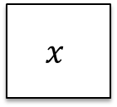





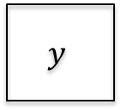
AES Encryption
128-bit
secret key $K$
Key expansion
$$K^{0}$$
$$K^{1}$$
$$K^{2}$$
$$K^{10}$$
128-bit round keys
AddRoundKey
4
4
SubBytes
ShiftRows
MixColumns
SubBytes
ShiftRows
MixColumns
SubBytes
ShiftRows
$$x$$
⨁
$$y$$
4
⨁
⨁
⨁
⨁
4
Round 1
Round 2
Round 10
Message/Ciphertext: a matrix of 16 byte, called state
Key expansion: 128-bit secret key$→$ 11 round keys (128-bit)
Round 1-Round 9: SubBytes, ShiftRows, MixColumns, AddRoundKey
Round 10: SubBytes, ShiftRows, AddRoundKey

Slide 3
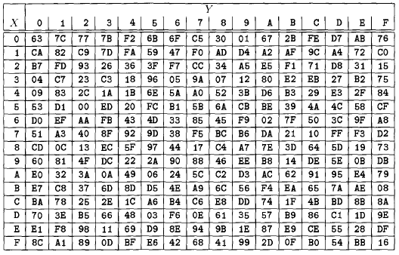
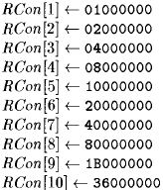


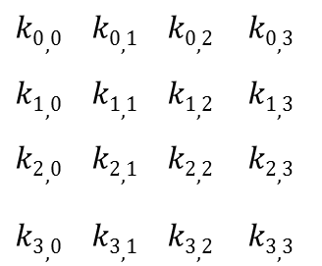



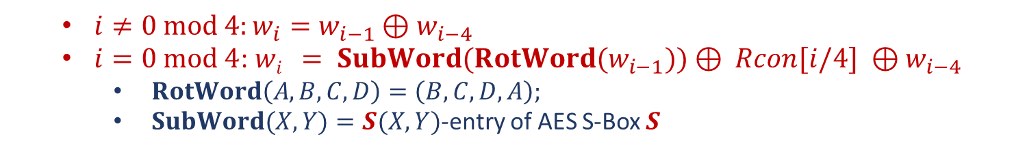


Key Expansion
$$K$$
$S$: AES S-Box
Constants
$$k0,0 k0,1 k0,2 k0,3$$
$$k1,0 k1,1 k1,2 k1,3$$
$$k2,0 k2,1 k2,2 k2,3$$
$$k3,0 k3,1 k3,2 k3,3$$
$$w0 w1 w2 w3 w4 w5 w6 w7 w8 w9 w42 w43$$
$$⋯$$
$$K^{0}$$
$$K^{1}$$
$$K^{2}$$
$$K^{10}$$
$i≠0 mod 4:w_{i}=w_{i−1}⊕w_{i−4}$
$i=0 mod 4$: $wi = SubWord(RotWord(w_{i−1}))⊕ Rcon[i/4] ⊕w_{i−4}$
$RotWord\left(A,B,C,D\right)=\left(B,C,D,A\right);$
$SubWord(X,Y)=S(X,Y)$-entry of AES S-Box $S$

Slide 4
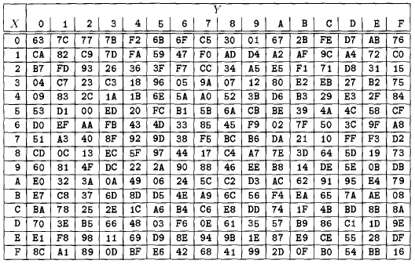
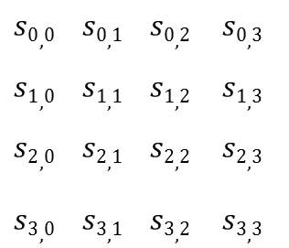

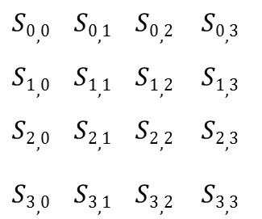
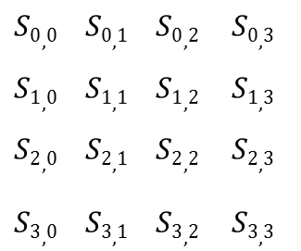
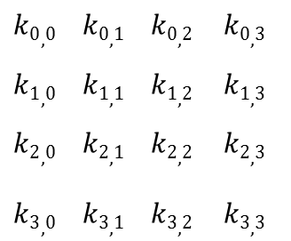

AddRoundKey and SubBytes
AddRoundKey($s,K^{i}$): XOR the state $s$ with the round key $K^{i}$
$$s0,0 s0,1 s0,2 s0,3$$
$$s1,0 s1,1 s1,2 s1,3$$
$$s2,0 s2,1 s2,2 s2,3$$
$$s3,0 s3,1 s3,2 s3,3$$
$$k0,0 k0,1 k0,2 k0,3$$
$$k1,0 k1,1 k1,2 k1,3$$
$$k2,0 k2,1 k2,2 k2,3$$
$$k3,0 k3,1 k3,2 k3,3$$
$$S0,0 S0,1 S0,2 S0,3$$
$$S1,0 S1,1 S1,2 S1,3$$
$$S2,0 S2,1 S2,2 S2,3$$
$$S3,0 S3,1 S3,2 S3,3$$
$$→$$
SubBytes($s$): $\left(X,Y\right)←S\left(X,Y\right), \left(X,Y\right)=s_{i,j}$ is any entry of the state
$$s0,0 s0,1 s0,2 s0,3$$
$$s1,0 s1,1 s1,2 s1,3$$
$$s2,0 s2,1 s2,2 s2,3$$
$$s3,0 s3,1 s3,2 s3,3$$
$$S0,0 S0,1 S0,2 S0,3$$
$$S1,0 S1,1 S1,2 S1,3$$
$$S2,0 S2,1 S2,2 S2,3$$
$$S3,0 S3,1 S3,2 S3,3$$
$$→$$

Slide 5
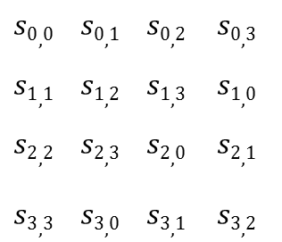

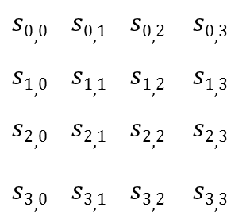

ShiftRows and MixColumns
ShiftRows($s$): shift the rows of the state to the left
$$s0,0 s0,1 s0,2 s0,3$$
$$s1,0 s1,1 s1,2 s1,3$$
$$s2,0 s2,1 s2,2 s2,3$$
$$s3,0 s3,1 s3,2 s3,3$$
$$s0,0 s0,1 s0,2 s0,3$$
$$s1,1 s1,2 s1,3 s1,0$$
$$s2,2 s2,3 s2,0 s2,1$$
$$s3,3 s3,0 s3,1 s3,2$$
$$→$$
MixColumns($s$): Multiplications over $𝔽_{2^{8}}$
02 03 01 01
01 02 03 01
01 01 02 03
03 01 01 02
$$s0,0 s0,1 s0,2 s0,3$$
$$s1,0 s1,1 s1,2 s1,3$$
$$s2,0 s2,1 s2,2 s2,3$$
$$s3,0 s3,1 s3,2 s3,3$$
$$S0,0 S0,1 S0,2 S0,3$$
$$S1,0 S1,1 S1,2 S1,3$$
$$S2,0 S2,1 S2,2 S2,3$$
$$S3,0 S3,1 S3,2 S3,3$$
*
$$→$$

Slide 6
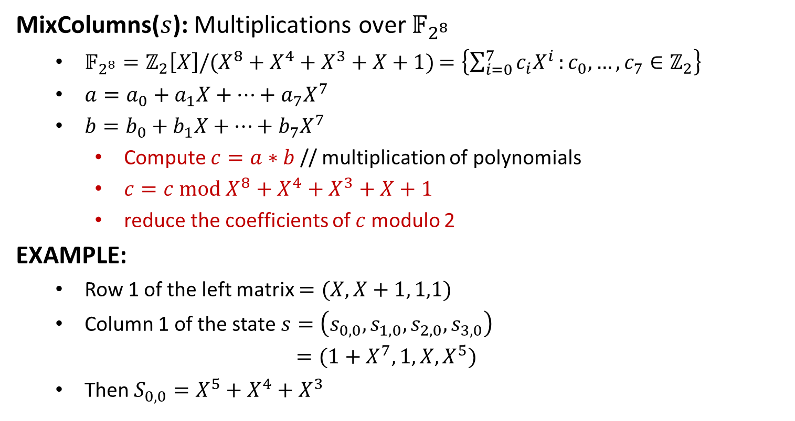
MixColumns
MixColumns($s$): Multiplications over $𝔽_{2^{8}}$
$𝔽_{2^{8}}=ℤ_{2}\left[X\right]/(X^{8}+X^{4}+X^{3}+X+1)$ $=\left\{\sum_{i=0}^{7}{c_{i}X^{i}}:c_{0},…,c_{7}∈ℤ_{2}\right\}$
$a=a_{0}+a_{1}X+⋯+a_{7}X^{7}$
$b=b_{0}+b_{1}X+⋯+b_{7}X^{7}$
Compute $c=a∗b$ // multiplication of polynomials
$c=c mod X^{8}+X^{4}+X^{3}+X+1$
reduce the coefficients of $c$modulo 2
EXAMPLE:
Row 1 of the left matrix $=(X, X+1, 1,1)$
Column 1 of the state $s=\left(s_{0,0},s_{1,0},s_{2,0},s_{3,0}\right)$
$=(1+X^{7}, 1,X,X^{5})$
Then $S_{0,0}=X^{5}+X^{4}+X^{3}$

Slide 7
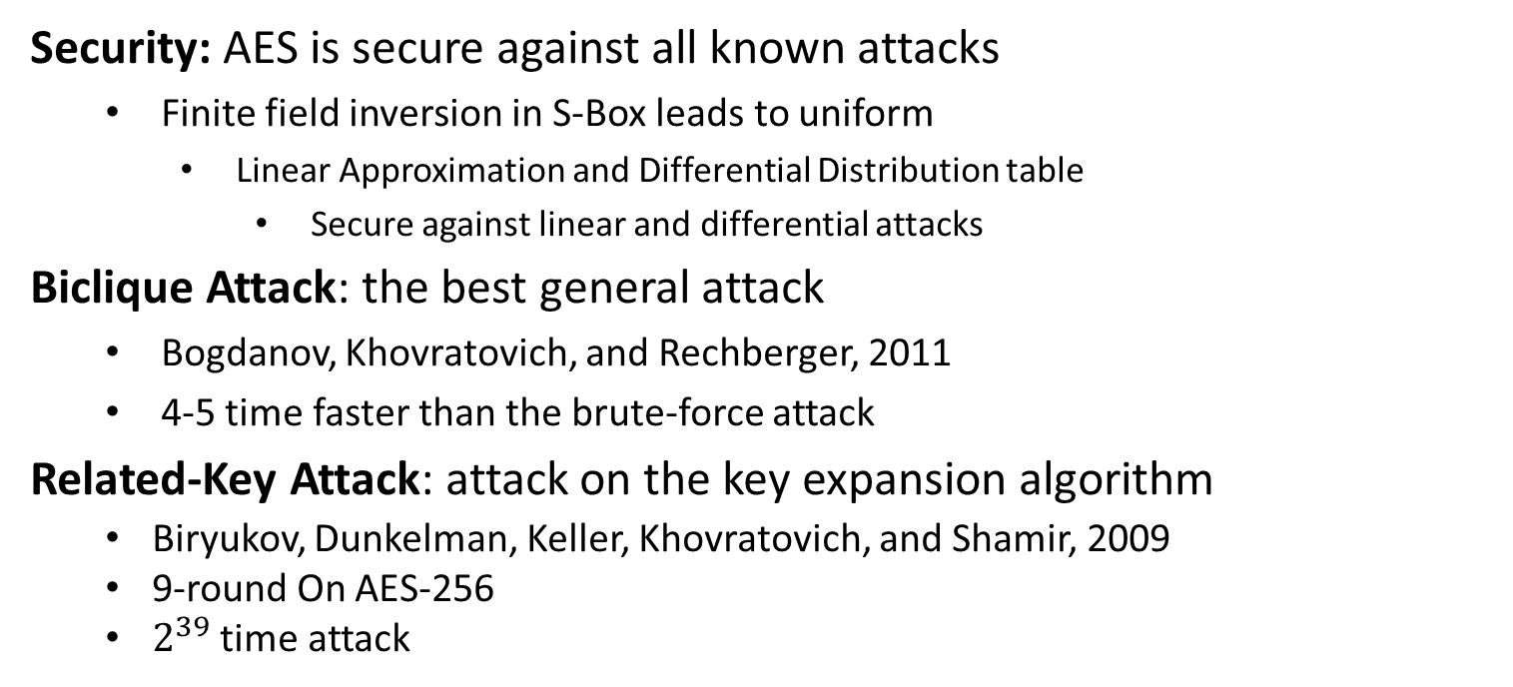
Analysis of AES
Security: AES is secure against all known attacks
Finite field inversion in S-Box leads to uniform
Linear Approximation and Differential Distribution table
Secure against linear and differential attacks
Biclique Attack: the best general attack
Bogdanov, Khovratovich, and Rechberger, 2011
4-5 time faster than the brute-force attack
Related-Key Attack: attack on the key expansion algorithm
Biryukov, Dunkelman, Keller, Khovratovich, and Shamir, 2009
9-round On AES-256
$2^{39}$ time attack

Slide 9
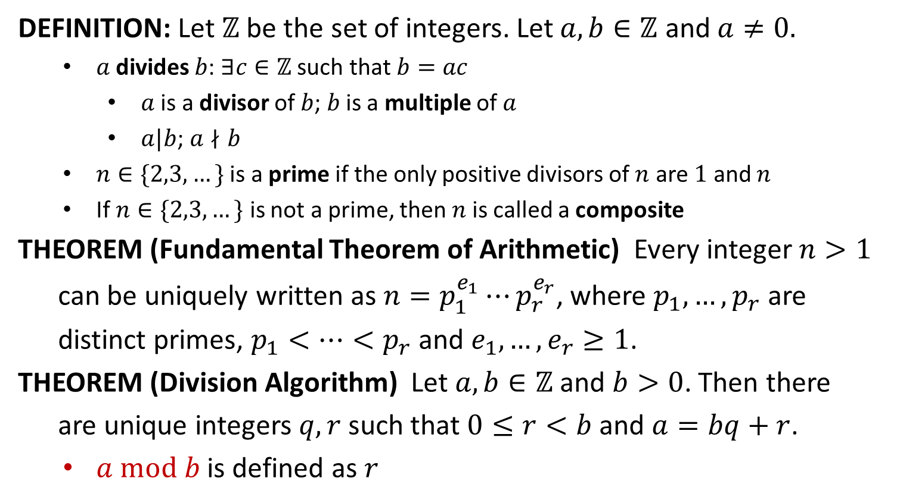
Divisibility
DEFINITION: Let $ℤ$ be the set of integers. Let $a,b∈ℤ$ and $a≠0.$
$a$ divides $b$: $∃c∈ℤ$ such that $b=ac$
$a$ is a divisor of $b$; $b$ is a multiple of $a$
$a|b$; $a∤b$
$n∈\{2,3,…\}$ is a prime if the only positive divisors of $n$ are $1$ and $n$
If $n∈\{2,3,…\}$ is not a prime, then$n$is called a composite
THEOREM (Fundamental Theorem of Arithmetic) Every integer $n>1$
can be uniquely written as $n=p_{1}^{e_{1}}⋯p_{r}^{e_{r}}$, where $p_{1},…,p_{r}$ are
distinct primes, $p_{1}<…<p_{r}$ and $e_{1},…,e_{r}≥1$.
THEOREM (Division Algorithm) Let $a,b∈ℤ$ and $b>0$. Then there
are unique integers $q,r$ such that $0≤r<b$ and $a=bq+r$.
$a mod b$ is defined as $r$

Slide 10
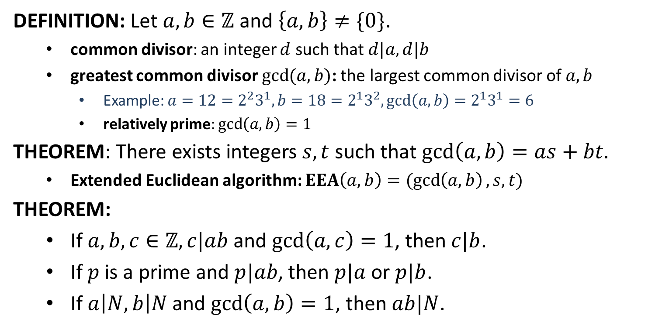
Greatest Common Divisor
DEFINITION: Let $a,b∈ℤ$ and $\left\{a,b\right\}≠\{0\}$.
common divisor: an integer $d$ such that $d|a, d|b$
greatest common divisor $\gcd{(a,b)}$: the largest common divisor of $a,b$
Example: $a=12=2^{2}3^{1}, b=18=2^{1}3^{2}, gcd\left(a,b\right)=2^{1}3^{1}=6$
relatively prime: $\gcd\left(a,b\right)=1$
THEOREM: There exists integers $s,t$ such that $\gcd\left(a,b\right)=as+bt.$
Extended Euclidean algorithm: $EEA\left(a,b\right)=(\gcd\left(a,b\right), s,t)$
THEOREM:
If $a,b,c∈ℤ, c|ab$and $\gcd\left(a,c\right)=1$, then $c|b$.
If $p$ is a prime and $p|ab$, then $p|a$ or $p|b$.
If $a\left|N, b\right|N$ and $\gcd\left(a,b\right)=1$, then $ab|N$.

Slide 11
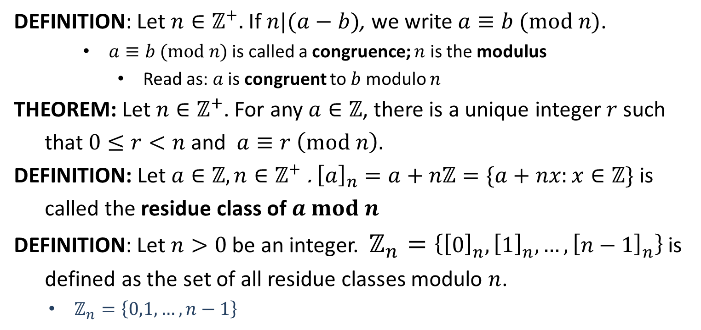
Congruence
DEFINITION: Let $n∈ℤ^{+}.$ If $n|(a−b)$, we write $a≡b (mod n)$.
$a≡b (mod n)$ is called a congruence; $n$ is the modulus
Read as: $a$ is congruent to $b$ modulo $n$
THEOREM: Let $n∈ℤ^{+}$. For any $a∈ℤ$, there is a unique integer $r$ such
that $0≤r<n$ and $a≡r \left(mod n\right).$
DEFINITION: Let $a∈ℤ,n∈ℤ^{+}$. ${\left[a\right]}_{n}=a+nℤ=\{a+nx:x∈ℤ\}$ is
called the residue class of $a mod n$
DEFINITION: Let $n>0$ be an integer. $ℤ_{n}=\left\{{\left[0\right]}_{n}, {\left[1\right]}_{n}, …, {\left[n−1\right]}_{n}\right\}$ is
defined as the set of all residue classes modulo $n$.
$ℤ_{n}=\left\{0,1,…,n−1\right\}$

Slide 12
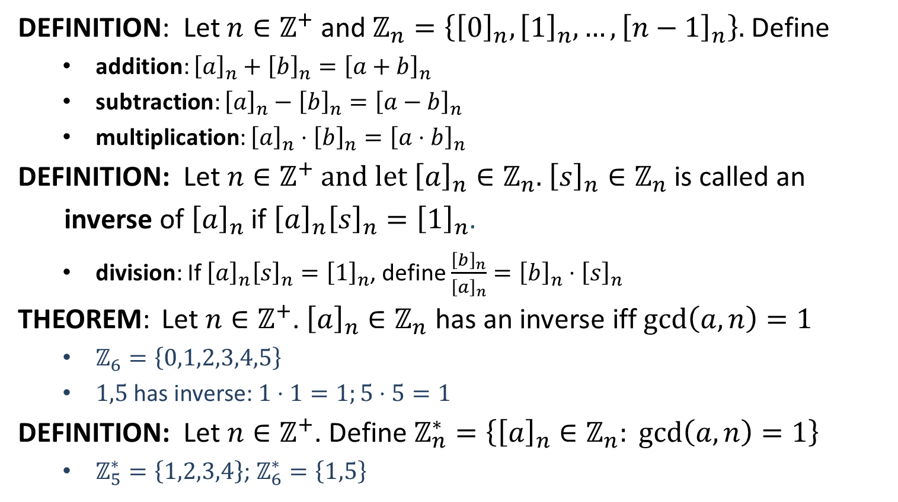
Residue Classes
DEFINITION: Let $n∈ℤ^{+}$ and $ℤ_{n}=\left\{{\left[0\right]}_{n}, {\left[1\right]}_{n}, …, {\left[n−1\right]}_{n}\right\}.$ Define
addition: ${\left[a\right]}_{n}+{\left[b\right]}_{n}={\left[a+b\right]}_{n}$
subtraction: ${\left[a\right]}_{n}−{\left[b\right]}_{n}={\left[a−b\right]}_{n}$
multiplication: ${\left[a\right]}_{n}⋅{\left[b\right]}_{n}={\left[a⋅b\right]}_{n}$
DEFINITION: Let $n∈ℤ^{+}$ and let ${\left[a\right]}_{n}∈ℤ_{n}$. ${\left[s\right]}_{n}∈ℤ_{n}$ is called an
inverse of ${\left[a\right]}_{n}$ if ${\left[a\right]}_{n}{\left[s\right]}_{n}={\left[1\right]}_{n}$.
division: If ${\left[a\right]}_{n}{\left[s\right]}_{n}={\left[1\right]}_{n}$, define $\frac{{\left[b\right]}_{n}}{{\left[a\right]}_{n}}={\left[b\right]}_{n}⋅{\left[s\right]}_{n}$
THEOREM: Let $n∈ℤ^{+}$. ${\left[a\right]}_{n}∈ℤ_{n}$ has an inverse iff $\gcd\left(a,n\right)=1$
$ℤ_{6}=\left\{0,1,2,3,4,5\right\}$
$1,5$ has inverse: $1⋅1=1;5⋅5=1$
DEFINITION: Let $n∈ℤ^{+}$. Define $ℤ_{n}^{∗}=\left\{{\left[a\right]}_{n}∈ℤ_{n}: \gcd\left(a,n\right)=1\right\}$
$ℤ_{5}^{∗}=\left\{1,2,3,4\right\}$; $ℤ_{6}^{∗}=\left\{1,5\right\}$

Slide 13
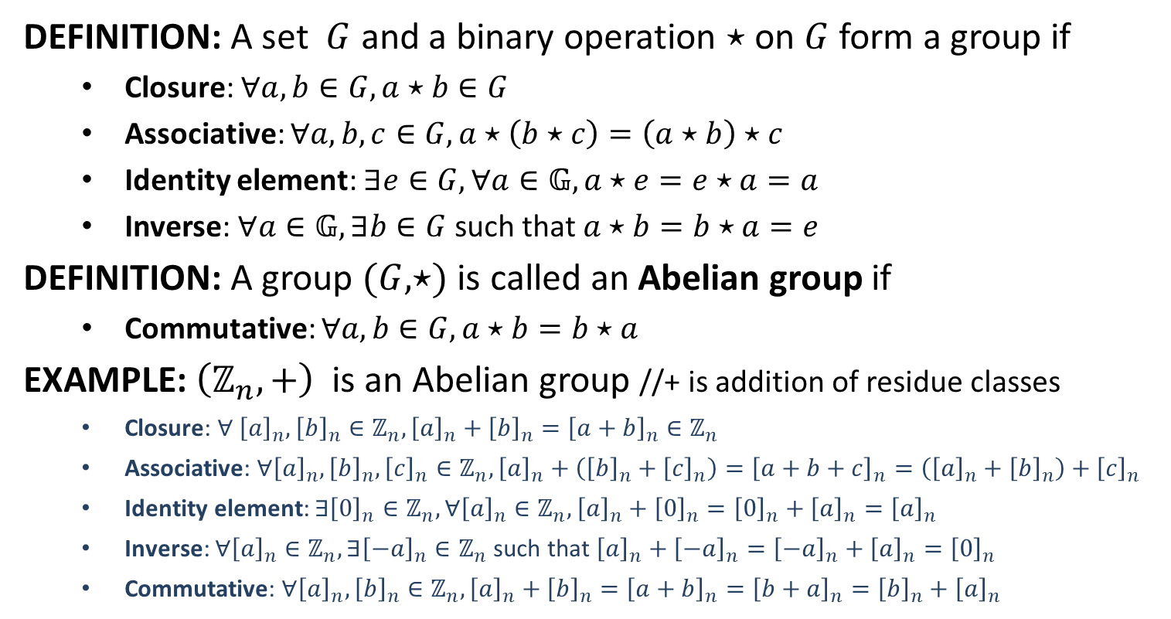
Group
DEFINITION: A set $G$ and a binary operation $⋆$ on $G$ form a group if
Closure: $∀a,b∈G, a⋆b∈G$
Associative: $∀a,b,c∈G, a⋆\left(b⋆c\right)=\left(a⋆b\right)⋆c$
Identity element: $∃e∈G, ∀a∈𝔾, a⋆e=e⋆a=a$
Inverse: $∀a∈𝔾,∃b∈G$ such that $a⋆b=b⋆a=e$
DEFINITION: A group $(G,⋆)$ is called an Abelian group if
Commutative: $∀a,b∈G, a⋆b=b⋆a$
EXAMPLE: $\left(ℤ_{n},+\right)$ is an Abelian group //+ is addition of residue classes
Closure: $∀ {\left[a\right]}_{n},{\left[b\right]}_{n}∈ℤ_{n}, {\left[a\right]}_{n}+{\left[b\right]}_{n}={\left[a+b\right]}_{n}∈ℤ_{n}$
Associative: $∀{\left[a\right]}_{n},{\left[b\right]}_{n},{\left[c\right]}_{n}∈ℤ_{n}, {\left[a\right]}_{n}+\left({\left[b\right]}_{n}+{\left[c\right]}_{n}\right)={\left[a+b+c\right]}_{n}=\left({\left[a\right]}_{n}+{\left[b\right]}_{n}\right)+{\left[c\right]}_{n}$
Identity element: $∃{\left[0\right]}_{n}∈ℤ_{n}, ∀{\left[a\right]}_{n}∈ℤ_{n}, {\left[a\right]}_{n}+{\left[0\right]}_{n}={\left[0\right]}_{n}+{\left[a\right]}_{n}={\left[a\right]}_{n}$
Inverse: $∀{\left[a\right]}_{n}∈ℤ_{n},∃{\left[−a\right]}_{n}∈ℤ_{n}$ such that ${\left[a\right]}_{n}+{\left[−a\right]}_{n}={\left[−a\right]}_{n}+{\left[a\right]}_{n}={\left[0\right]}_{n}$
Commutative: $∀{\left[a\right]}_{n}, {\left[b\right]}_{n}∈ℤ_{n}, {\left[a\right]}_{n}+{\left[b\right]}_{n}={\left[a+b\right]}_{n}={\left[b+a\right]}_{n}={\left[b\right]}_{n}+{\left[a\right]}_{n}$

Slide 14
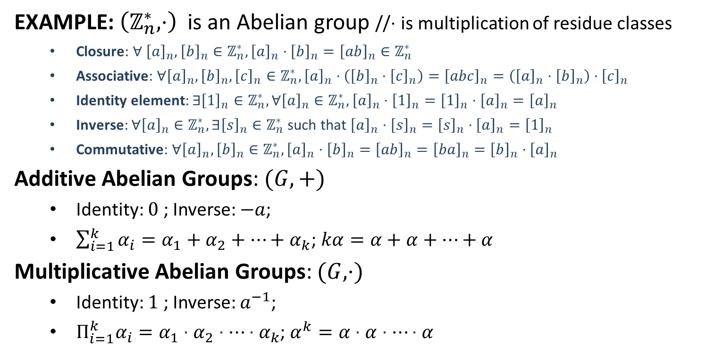
Group
EXAMPLE: $\left(ℤ_{n}^{∗},⋅\right)$ is an Abelian group //$⋅$ is multiplication of residue classes
Closure: $∀ {\left[a\right]}_{n},{\left[b\right]}_{n}∈ℤ_{n}^{∗}, {\left[a\right]}_{n}⋅{\left[b\right]}_{n}={\left[ab\right]}_{n}∈ℤ_{n}^{∗}$
Associative: $∀{\left[a\right]}_{n},{\left[b\right]}_{n},{\left[c\right]}_{n}∈ℤ_{n}^{∗}, {\left[a\right]}_{n}⋅\left({\left[b\right]}_{n}⋅{\left[c\right]}_{n}\right)={\left[abc\right]}_{n}=\left({\left[a\right]}_{n}⋅{\left[b\right]}_{n}\right)⋅{\left[c\right]}_{n}$
Identity element: $∃{\left[1\right]}_{n}∈ℤ_{n}^{∗}, ∀{\left[a\right]}_{n}∈ℤ_{n}^{∗}, {\left[a\right]}_{n}⋅{\left[1\right]}_{n}={\left[1\right]}_{n}⋅{\left[a\right]}_{n}={\left[a\right]}_{n}$
Inverse: $∀{\left[a\right]}_{n}∈ℤ_{n}^{∗},∃{\left[s\right]}_{n}∈ℤ_{n}^{∗}$ such that ${\left[a\right]}_{n}⋅{\left[s\right]}_{n}={\left[s\right]}_{n}⋅{\left[a\right]}_{n}={\left[1\right]}_{n}$
Commutative: $∀{\left[a\right]}_{n}, {\left[b\right]}_{n}∈ℤ_{n}^{∗}, {\left[a\right]}_{n}⋅{\left[b\right]}_{n}={\left[ab\right]}_{n}={\left[ba\right]}_{n}={\left[b\right]}_{n}⋅{\left[a\right]}_{n}$
Additive Abelian Groups: $(G,+)$
Identity: $0$ ; Inverse: $−a$;
$\sum_{i=1}^{k}{α_{i}}=α_{1}+α_{2}+⋯+α_{k}$; $kα=α+α+⋯+α$
Multiplicative Abelian Groups: $(G,⋅)$
Identity: $1$ ; Inverse: $a^{−1}$;
$Π_{i=1}^{k}α_{i}=α_{1}⋅α_{2}⋅⋯⋅α_{k}$; $α^{k}=α⋅α⋅⋯⋅α$

Slide 15
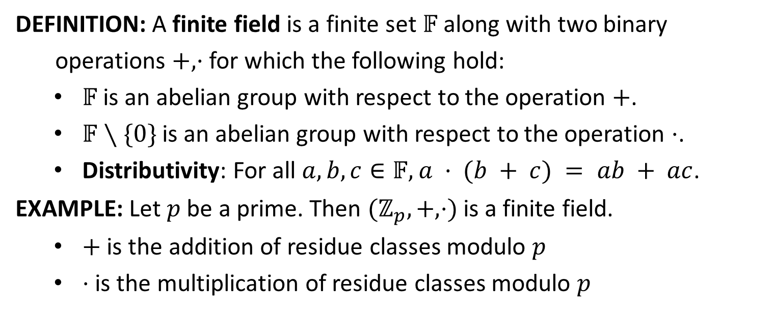
Finite Field
DEFINITION: A finite field is a finite set $𝔽$ along with two binary
operations $+, ·$ for which the following hold:
$𝔽$ is an abelian group with respect to the operation $+$.
$𝔽∖\{0\}$ is an abelian group with respect to the operation $⋅$.
Distributivity: For all $a,b,c∈𝔽,$ $a · (b + c) = ab + ac$.
EXAMPLE: Let $p$ be a prime. Then $(ℤ_{p}, +, ⋅)$ is a finite field.
$+$ is the addition of residue classes modulo $p$
$⋅$ is the multiplication of residue classes modulo $p$

